Slide 1

Arkema-Calvert City
Presenters: Grant Eyer and Logan Draffen

Slide 2
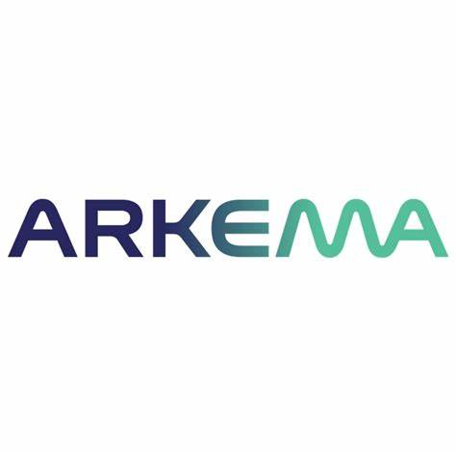

About Arkema
Facts about Arkema:
Headquartered in France
Manufactures specialty materials
Has 43 facilities in the United States
Employs roughly 3,600 people nationwide
Facts about Arkema-Calvert City:
Has operated for over 70 years
Has around 250 employees
Produces food grade HCl, Kynar® PVDF resin, and Forane® Refrigerants, etc.
Made the resin for the “Tree of Life” leaves.

Slide 3
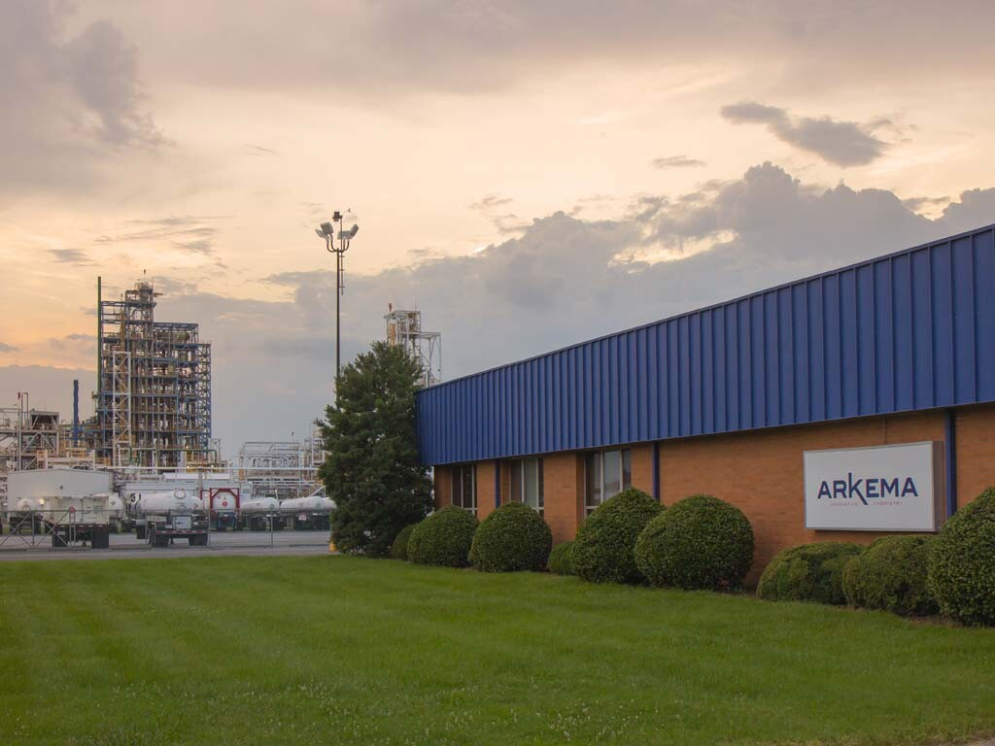
Internship Experience
Job Title: Process Technology Intern
Collaborated with:
Supervisor: Michael Klimek
Engineering Technology Department
King of Prussia (U.S. Headquarters)
Main Tasks:
Markup PFDs and P&IDs
Created PI Vision graphics for new F-1233zd process.

Slide 4
Arkema-Calvert City | Looking Ahead
Opportunities:
Developing Engineer Program
Logan Draffen on other future Arkema opportunities…
Advice:
Check emails daily!
Apply as soon as possible
Get help with resume formatting

